Slide 1

Title:Intelligent prediction of crops based on season
Review - 3
Date :16-01-23
USN Name
1CR21AI007 Amrita Sharma
1CR21AI061 Vanusha R
iCR21AI057 Tejas K
Under the guidance of:
Guide Name:Mrs. Sowmya T
Designation: Assistant Professor, Computer Science Artificial Intelligence
Department of Computer Science & Engineering

Slide 2
Building an AI that predicts crop based on season

Slide 3
PROBLEM STATEMENT
THE PROBLEM TODAY'S FARMERS ARE FACING IS THAT THEY WILL PREFER THE
PRIOR OR NEIGHBORHOOD OR MORE TREND CROP IN THE SURROUNDING REGION
ONLY FOR THEIR LAND AND THEY DON’T HAVE ENOUGH OF KNOWLEDGE ABOUT
SOIL NUTRIENTS CONTENT SUCH AS NITROGEN, PHOSPHORUS, POTASSIUM IN
THE LAND. BEING THIS AS THE CURRENT SITUATION WITHOUT THE ROTATION OF
THE CROP AND APPLY AN INADEQUATE AMOUNT OF NUTRIENTS TO SOIL IT
LEADS TO REDUCE IN THE YIELD AND SOIL POLLUTION (SOIL ACIDIFICATION) AND
DAMAGES THE TOP LAYER. CONSIDERING ALL THESE PROBLEMS TAKES INTO
THE ACCOUNT WE DESIGNED THE SYSTEM USING A MACHINE LEARNING FOR
BETTERMENT OF THE FARMER. MACHINE LEARNING(ML) IS A GAME CHANGER
FOR AGRICULTURE SECTOR

Slide 4
DETAILED REQUIREMENTS
THE MAIN REQUIREMENTS FOR THIS PROJECT WOULD BE
INTERMEDIATE UNDERSTAND OF PYTHON PROGRAMMING LANGUAGE
AND BASIC UNDERSTANDING OF MACHINE LEARNING AND IT'S
IMPLEMENTATION USING PYTHON
THE SECOND REQUIREMENT FOR THE PROJECT IS WEBSITE
DEVELOPMENT USING HTML ,CSS AND JAVASCRIPT
THE LAST REQUIREMENT FOR THE PROJECT IS FLASK WICH IS USED
FOR BACKEND WEB SUPPORT.

Slide 5
SOFTWARE TOOLS USED
The project is implemented using the combination of Machine Learning and programming concepts.
The data set used to predict the output is taken from Kaggle. The data set consists of about 22 different types of crops with around 2000+ different entries of these crops.
The website is developed using HTML, CSS and Javascript.
Flask is used for backend web support. Flask is a micro web framework written in Python. It is classified as a microframework because it does not require particular tools or libraries. It has no database abstraction layer, form validation, or any other components where pre-existing third-party libraries provide common functions.
React is used for building the website. It is a JavaScript library for building user interfaces. React is used to build single-page applications. React allows us to create reusable UI components.

Slide 6
PROPOSED SOLUTION
THE PROPOSED SOLUTION TO THIS MODEN DAY PROBLEM IS MACHINE
LEARNING.MACHINE LEARNING IS THE PART OF ARTIFICIAL
INTELLIGENCE, HAS EMERGED TOGETHER WITH BIGDATA
TECHNOLOGIES AND HIGH-PERFORMANCE COMPUTING TO CREATE
NEW OPPORTUNITIES FOR DATA INTENSIVE SCIENCE IN THE MULTI_x0002_DISCIPLINARY AGRICULTURE TECHNOLOGY DOMAIN. IN THE
AGRICULTURE FIELD MACHINE LEARNING FOR INSTANCE IS NOT A
MYSTERIOUS TRICK OR MAGIC, IT IS A SET OF WELL DEFINE MODEL
THAT COLLECT SPECIFIC DATA AND APPLY SPECIFIC ALGORITHMS TO
ACHIEVE EXPECTED RESULT

Slide 7
TOTAL MAN HOUR & WORKS
Total Man Hours = 36 hours.
Vanusha =12 hours
Tejas =12 hours
Amrita =12 hours

Slide 8
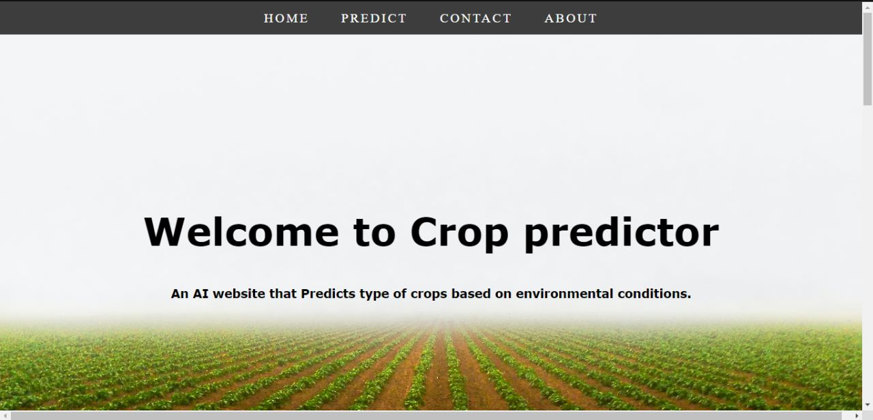
DESIGN

Slide 9
IMPLEMENTATION
Step 1: Data collection
Step 2: Data Preprocessing
Step 3: Implementation of Machine Learning model
Step 4: Design of website
Step 5: Backend support for the website

Slide 10
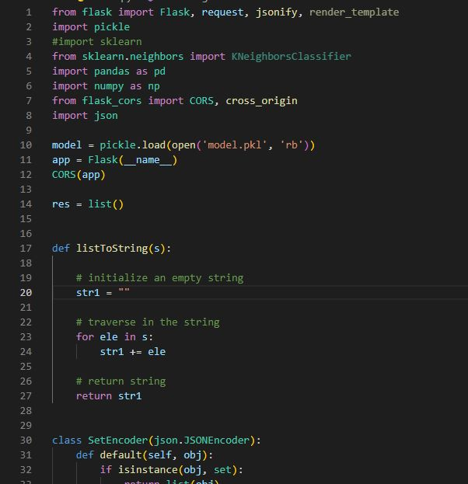
SOURCE CODE

Slide 11
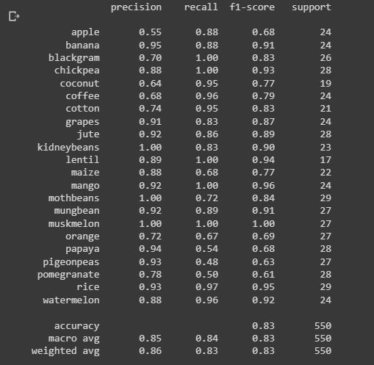

Slide 12
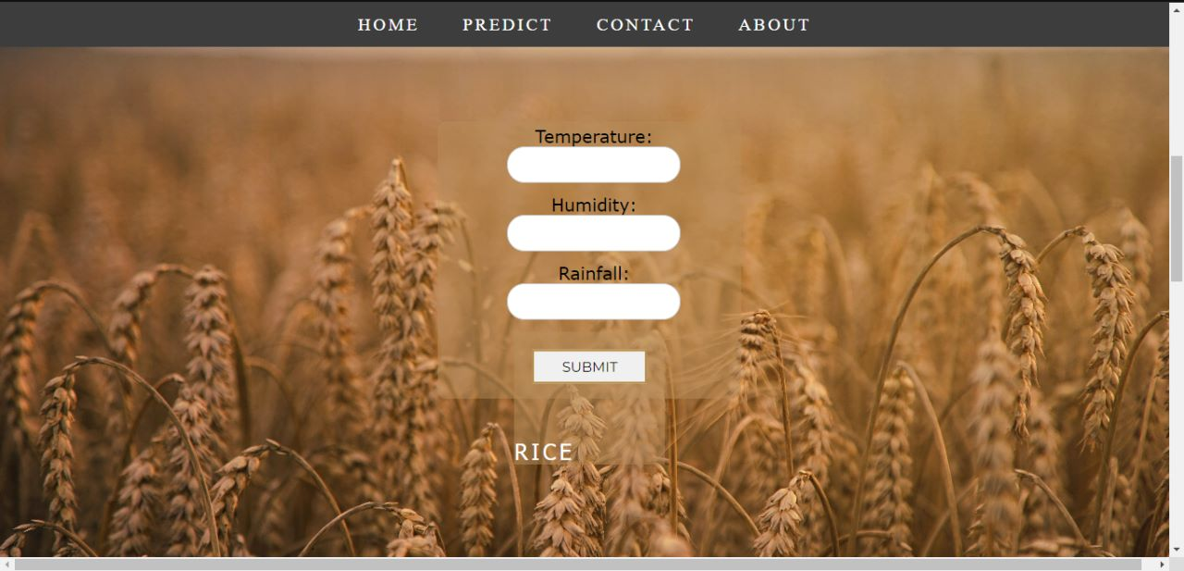
OUTPUT SCREENS

Slide 13
Thank you

